Slide 1
Introduction to Classes

Slide 2
Introduction to Classes
A class is the blueprint for an object.
It describes a particular type of object, yet it is not an object.
It specifies the fields and methods a particular type of object can have.
One or more object can be created from the class.
Each object created from a class is called an instance of the class.

Slide 3
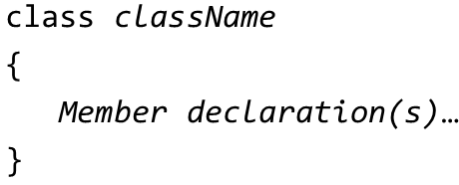
Creating a Class
You can create a class by writing a class declaration. A generic form is:
The class header is the first line. It starts with the keyword class, followed by the name of the class.
Member declarations are statements that define the class’s fields, properties, and/or methods.
A class may contain a constructor, which is special method automatically executed when an object is created.

Slide 4
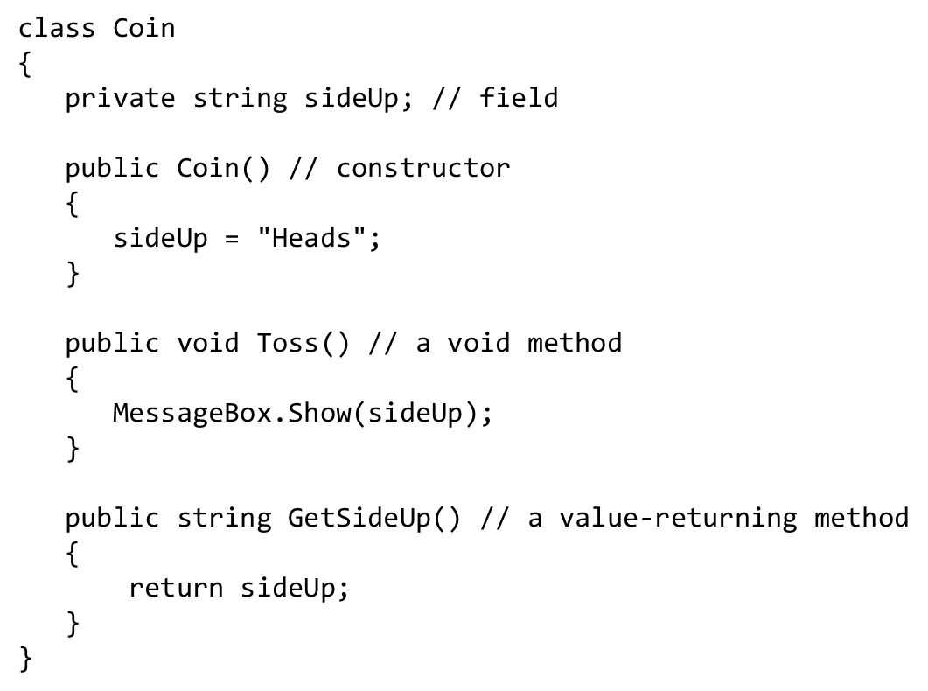
Sample Code

Slide 5


Creating an Object
Given a class named Coin, to create a Coin object use:
where,
myCoin is a variable that references an object of the Coin class;
the new keyword creates an instance of the Coin class; and
the = operator assigns the reference that was returned from the new operator to the myCoin variable.
Once a Coin object is created, you can access members of the class with it, as shown:

Slide 6
Where to Write Class Declarations (1 of 2)
In
you have flexibility to choose where to write class declarations
To create the Coin class, you can:
Save the class declaration as a separate .c s file
Or
Add the Coin class next to the Form1 class inside the Form1.cs file.

Slide 7
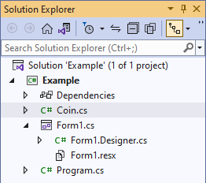
Where to Write Class Declarations (2 of 2)
namespace Example
{
public partial class Form1 : Form
{
public Form1()
{
InitializeComponent();
}
}
class Coin
{
...
}
}

Slide 8
Scope of Fields
A field may be accessed by any method in the class in which the field is declared.
If a field is declared as private, it cannot be accessed by code outside the class.
If a field is declared as public, it can be accessed by code outside the class.

Slide 9
Shadowing
A method can have a parameter or a local variable with the same name as a field in the same class.
When this happens, the name of the parameter or local variable shadows the name of the field.
This means the field name is hidden by the name of the parameter or local variable.
As a result, the field cannot be accessed within the method.

Slide 10
Initializing Fields at Declaration
A field can be initialized in its declaration statement in the same way that a local variable can be initialized
after the name of the field, you write an = operator, followed by a value.
class Coin
{
private string sideUp = "Heads";
public void Toss()
{
...
}
public string GetSideUp()
{
...
}
}

Slide 11
Uninitialized Fields
If a field is uninitialized and is not assigned a value by a constructor, it is automatically set to a default value that is determined by the field's data type.
Integer fields are set to 0 and floating-point fields are set to 0.0
bool fields are set to false
char fields are set to '\0'
string fields are set to null
reference type fields are set to null
enum fields are set to 0
If a field is a struct, its members are set to the default values determined by their type, as described above

Slide 12
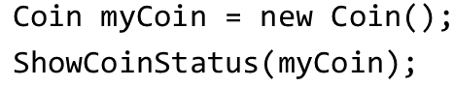
Passing an Object to a Method
Objects of a class can be used as parameters of a method. Here is an example:
private void ShowCoinStatus(Coin coin)
{
MessageBox.Show($"Side is {coin.GetSideUp()}");
}
In this example, a method named ShowCoinStatus accepts a Coin object as an argument.
To create a Coin object and pass it as an argument to the ShowCoinStatus method, use:

Slide 13
Properties (1 of 2)
A property is a class member that holds a piece of data about an object.
Properties can be implemented as special methods that set and get the value of corresponding fields.
In the code, there is a private field which is known as the backing field and is used to hold any data assigned to the property.
The value parameter of the set accessor is automatically created by the compiler.

Slide 14
Properties (2 of 2)
class Pet
{
private string _name; // Backing Field
public Pet()
{
_name = "";
}
public string Name
{
get
{
return _name;
}
set
{
_name = value;
}
}
}

Slide 15
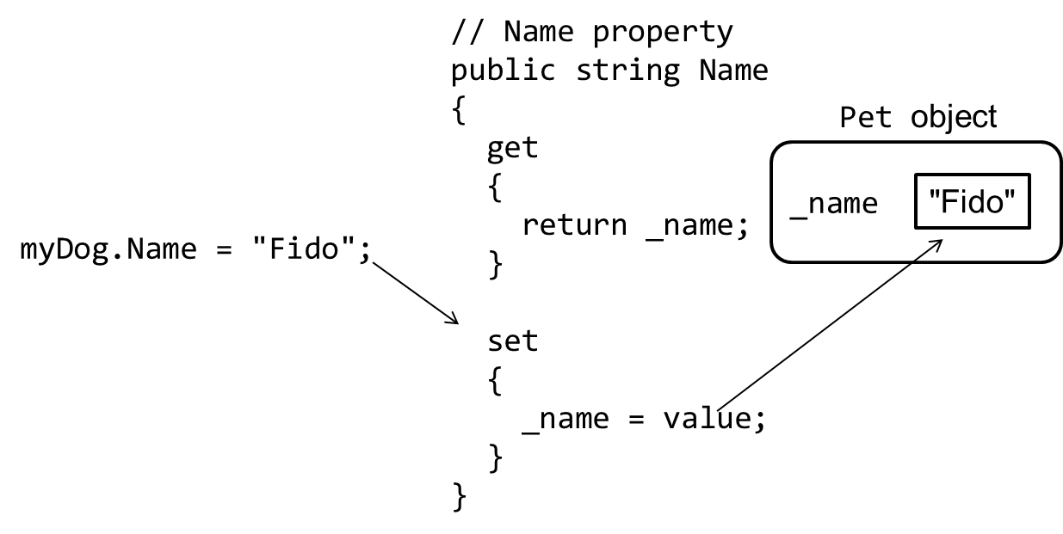
Setting the my Dog Object’s Name Property to “Fido”

Slide 16
The Backing Field
The private backing field is a variable that stores a value assigned to the property which the backing field is associated with.
It is declared to be private to protect it from accidental corruption.
If a backing field is public, it can then be accessible directly by code outside the class without the need for accessors.

Slide 17
get vs set Accessors
The get accessor, if not empty, is a method that returns the property’s value because it has a return statement.
It is executed whenever the property is read.
The set accessor, if not empty, gets the value stored in the backing field and assigns the value to the property
It has an implicit parameter named value.
It is executed whenever a value is assigned to the property.

Slide 18
Referring to a Property Inside the Class
Sometimes a class needs to work with its own properties.
When this is the case, the method can either work with the property by its name, or with the property's backing field.
class Car
{
private int _speed;
public Car()
{
Speed = 0;
}
public int Speed
{
get { return _speed; }
set { _speed = value; }
}
}
class Car
{
private int _speed;
public Car()
{
_speed = 0;
}
public int Speed
{
get { return _speed; }
set { _speed = value; }
}
}

Slide 19
Read-Only Properties (1 of 2)
A read-only property can be read, but it cannot be modified.
To set a read-only property:
Use the readonly keyword in the declaration of the backing field
Do not write a set accessor for the property

Slide 20
Read-Only Properties (2 of 2)
Example:
class Pet
{
private readonly string _name;
public Pet()
{
_name = "Fido";
}
public string Name
{
get
{
return _name;
}
}
}

Slide 21
Private set Accessors (1 of 2)
Sometimes you want a property to be read-only to code outside the class, but you want methods inside the class to be able to change the value of the property.
In these cases, you cannot use the readonly keyword to declare the property's backing field.
A field that is declared readonly can be assigned a value only at its declaration or in a constructor
Instead, give the property a private set accessor.
A property's private set accessor can be called only by code inside the same class as the property.

Slide 22
Private set Accessors (2 of 2)
Example:
class Car
{
private int _speed;
public Car()
{
Speed = 0;
}
public int Speed
{
get { return _speed; }
private set { _speed = value; }
}
public void Accelerate()
{
Speed += 10;
}
public void Brake()
{
Speed -= 10;
}
}

Slide 23
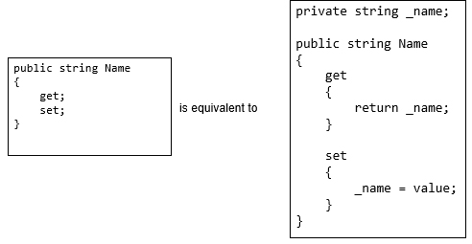
Auto-Properties (1 of 2)
Sometimes a property simply gets and sets the value of a backing field, without performing any other operation.
Auto-properties simplify the code for such a property. Example:

Slide 24

Auto-Properties (2 of 2)
With auto-properties, a hidden backing field is automatically created, as well as the code for the get and set methods.
In fact, most programmers prefer to write an even shorter version of the property, like this:
You can initialize an auto-property like this:

Slide 25
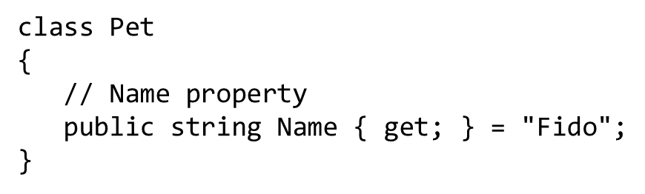
Read-Only Auto-Properties
If you leave out the set keyword in an auto-property, the property becomes read-only. Example:

Slide 26
Using Private set Accessors with Auto-Properties
Auto-properties can have private set accessors.
As previously discussed, a private set accessor can be called only by code inside the same class as the property.
Example: // Speed property public int Speed { get; private set; }

Slide 27
Parameterized Constructors and Method Overloading
A constructor that accepts arguments is known as parameterized constructor. For example:
A class can have multiple versions of the same method. This is known as overloaded methods.
How does the compiler know which method to call?
Binding relies on the signature of a method which consists of the method's name, the data type, and argument kind of the method's parameter. For example:
The process of matching a method call with the correct method is known as binding.

Slide 28

Overloading Methods
When a method is overloaded, it means that multiple methods in the same class have the same name but use different types of parameters.

Slide 29

Overloading Constructors
Constructors are special type of methods. They can also be overloaded.
The parameterless constructor is the default constructor
The compiler will find the matching constructors automatically. For example:

Slide 30
Default Constructors
If you write a class with no constructor, the compiler provides a default constructor that takes no arguments.
It is equivalent to a parameterless constructor that has no statements in its body. For example, this class
class Circle
{
public int CenterX { get; set; }
public int CenterY { get; set; }
}
Is equivalent to:
class Circle
{
public Circle()
{}
public int CenterX { get; set; }
public int CenterY { get; set; }
}

Slide 31


Storing Class Type Objects in Arrays and Lists
An array can hold references to objects. For example:
You can use a loop to step through the array. For example:

Slide 32


Initializing Array Elements
You can initialize the array elements in the declaration statement:

Slide 33


Lists of Class Type Objects
You can create a List to hold references to objects:
This statement creates a List object, referenced by the phoneList variable.
Each object of the CellPhone class needs an instance of the CellPhone class to hold data:
To add the Cellphone object to the List, use:

Slide 34
Finding the Classes and Their Responsibilities in a Problem
When developing an object-oriented program, you need to identify the classes that you need to create.
One simple and popular technique involves the following steps:
Get a written description of the problem domain.
Identify all the nouns (including pronouns and noun phrases) in the description. Each of these is a potential class.
Refine the list to include only the classes that are relevant to the problem.
Once the classes have been identified, you need to identify each class’s responsibilities. The responsibilities are:
The things that the class is responsible for knowing
The actions that the class is responsible for doing

Slide 35
Example (1 of 2)
In the textbook, there are three classes: Customer, Car, and ServiceQuote.
The Customer class has the following actions:
Create and initialize an object of the Customer class.
Get and set the customer’s name.
Get and set the customer’s address.
Get and set the customer’s telephone number.
The Car class has the following actions:
Create and initialize an object of the Car class.
Get and set the car’s make.

Slide 36
Example (2 of 2)
Get and set the car’s model.
Get and set the car’s year.
The ServiceQuote class has the following actions:
Create and initialize an object of the ServiceQuote class.
Get and set the estimated parts charges.
Get and set the estimated labor charges.
Get and set the sales tax rate.
Get the sales tax.
Get the total estimated charges.

Slide 37
Static Class Members
A static class member belongs to the class, not to objects instantiated from the class.
Recall:
Each instance of a class has its own set of instance fields and may have instance methods
Instance fields and instance methods are associated with a specific instance of a class
However, you can create a field, property, or method that does not belong to any instance of a class. These are known as static fields, static properties, and static methods. They are static members.

Slide 38
Static Fields (1 of 3)
When a field is declared with the static keyword, there is only one copy of the field in memory, regardless of how many instances there are of the class.
The following example uses a static field to keep count of the number of instances of the Countable class that are created.

Slide 39
Static Fields (2 of 3)
class Countable
{
// Static field
private static int instanceCount = 0;
// Constructor
public Countable()
{
instanceCount++;
}
// Method to get the value of instanceCount
public int GetInstanceCount()
{
return instanceCount;
}
}

Slide 40
Static Fields (3 of 3)
The following code creates three instances of the Countable class (obj1, obj2, obj3). You could call the GetInstanceCount method from any of the objects and get the same value.
// Create three Countable objects
Countable obj1 = new Countable();
Countable obj2 = new Countable();
Countable obj3 = new Countable();
// Get the number of instances
int numbObjects = obj3.GetInstanceCount();

Slide 41
Static Properties (1 of 3)
When a property is declared with the static keyword, there is only one copy of the property’s value in memory, regardless of how many instances there are of the class.
All instances of the class share that property.
The following example uses a static property to keep count of the number of instances of the Countable class that are created.

Slide 42
Static Properties (2 of 3)
class Countable
{
// Static property
public static int InstanceCount{get; set;} = 0;
// Constructor
public Countable()
{
instanceCount++;
}
}

Slide 43
Static Properties (3 of 3)
When the following code executes, the numObjects variable will be assigned the value 3.
// Create three Countable objects
Countable obj1 = new Countable();
Countable obj2 = new Countable();
Countable obj3 = new Countable();
// Get the number of instances
int numbObjects = Countable.InstanceCount;

Slide 44
Static Methods (1 of 3)
When a class contains a static method, it is not necessary to create an instance of the class to execute the method.
A static method is created by placing the static keyword after the access specifier in the method header.
The following example uses two static methods.

Slide 45
Static Methods (2 of 3)
class Metric
{
// This method converts miles to kilometers
public static double MilesToKilometers(double m)
{
return m * 1.609;
}
// This method converts kilometers to miles
public static double KilometersToMiles(double k)
{
return k / 1.609;
}
}

Slide 46
Static Methods (3 of 3)
These methods can be called without any instance of the class in existence. The following shows how to call these static methods:
double Kilometers = Metric.MilesToKilometers(10.0);
double Miles = Metric.KilometersToMiles(1609.0);
The first statement passes 10.0 as the argument and the second passes 1609.0 as the argument.

Slide 47
Static Classes
The static keyword can be used to declare a class as static.
If a class is declared static, all its members must also be static or a compiler error will occur.
If a class is declared static, the compiler will not allow you to instantiate the class.

